Slide 1


Drone follow-me
Applying reinforcement learning in the task of autonomous drone follow-me
Amir Pliev
Artificial Intelligence (UU)
ML6
14 May 20201

Slide 2
OUTLINE
Goal
Background
Research Questions
Methods
Results
Conclusions
Questions

Slide 3
Goal
Create an agent that can perform follow-me behavior using a standalone drone in a simulation
Requirements:
Use only camera inputs
Keep person centered
Keep specific distance

Slide 4
Background

Slide 5

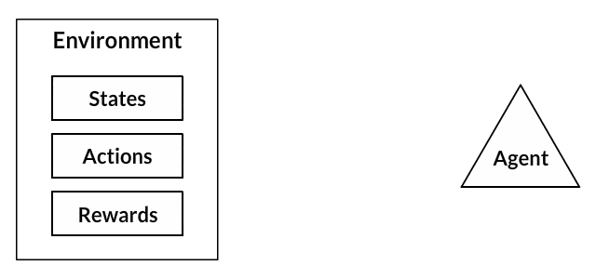
Background
Reinforcement Learning
Machine Learning
Classical Conditioning
Training a dog
Q-Learning
Neural Networks
Deep Q-Network (DQN)
(Three Things to Know About Reinforcement Learning, 2019)
(Kansal & Martin, 2018)

Slide 6
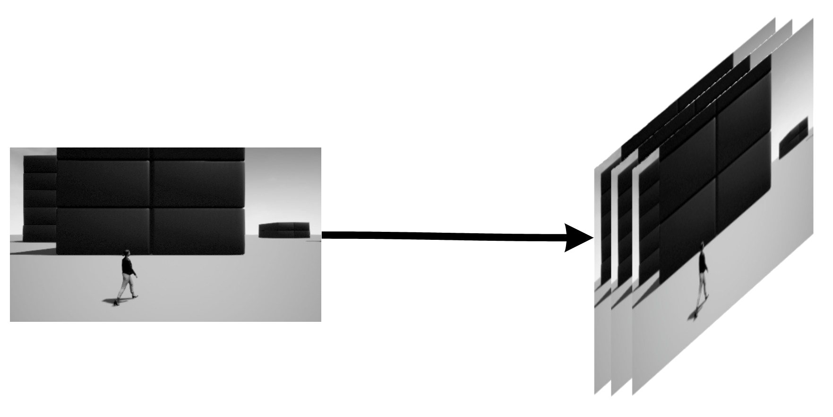
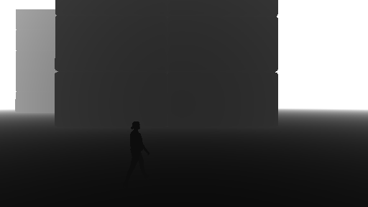
background
What are the important aspects of Reinforcement Learning?
Rewards
States
Movements - Stacks
Depth - Depth Images

Slide 7
Research Questions
MAIN: To what extent is the use of Reinforcement Learning in the task of Follow-Me
behavior applicable and beneficial?
Does the use of Stack improve learning and behavior of an RL agent?
Does the use of Depth maps improve learning and behavior of an RL agent?
Does RL provide any benefits over baseline?
Does RL show ability to generalize its behavior to more complex environments?

Slide 8
methods

Slide 9
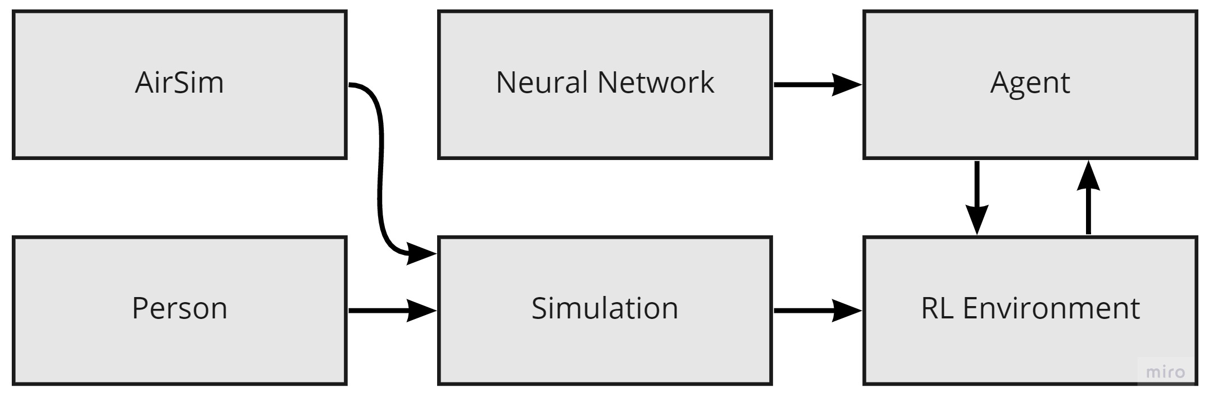
methods
Program architecture

Slide 10
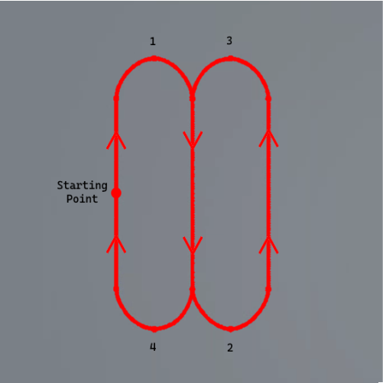
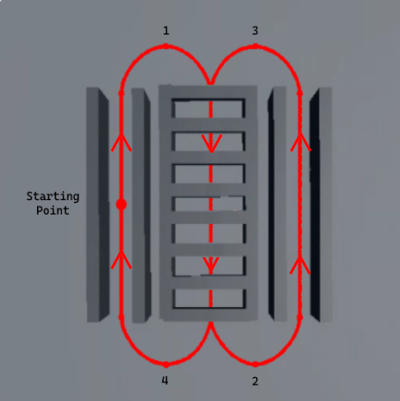
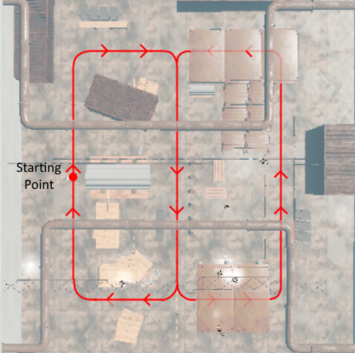
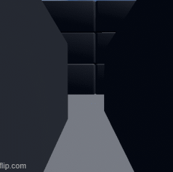
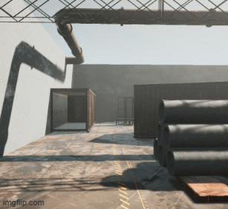
environments
bLOCKSNORMAL
BLOCKSOBSTACLES
WAREHOUSE

Slide 11
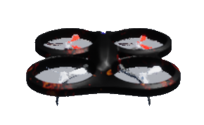
Agents
DQN:
Inputs
Stack, Normal and Depth combinations
Network
Small sized CNN with 2M parameters
Outputs/Actions
5 possible actions
Baseline
Move forward
Move left
Move right
Rotate left
Rotate right

Slide 12
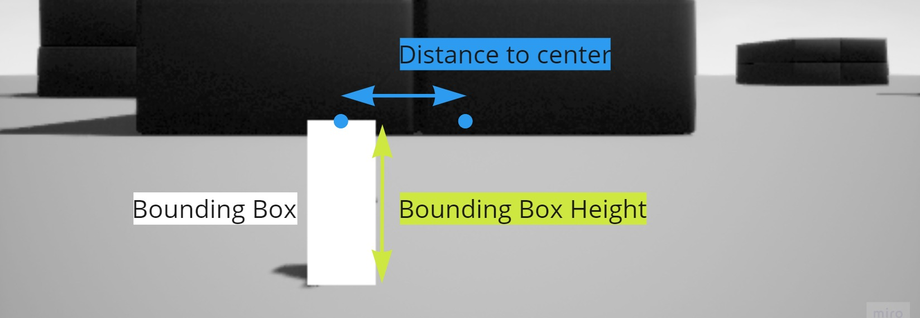
REWARD
Positive reward: +1 | Bounding Box Height = 30% of image height + margin Distance to Center = Center of image width + margin
Negative reward: -1 | Collisions and losing person
Neutral reward: 0 | All other situations

Slide 13
experiments
BlocksNormal
BlocksObstacles
Warehouse
Train:
Single Normal Images
Test Run
Stacked Normal Images
Test Run
Either Single or Stacked Depth Images
Test Run
Baseline Test
Exactly the same
+
New Reward Train/Test
Train:
New Agent
Test:
Best from BlocksNormal
Best from BlockObstacles
New Agent

Slide 14
results

Slide 15
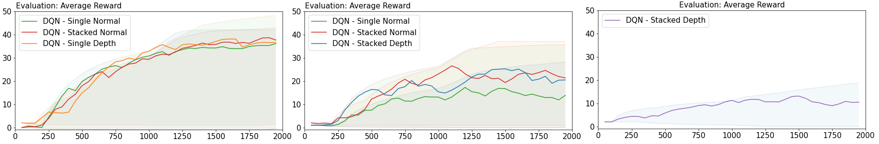
training
Training was similar
Increased complexity is means less average reward
BLOCKSNORMAL
BLOCKSOBSTACLES
WAREHOUSE

Slide 16
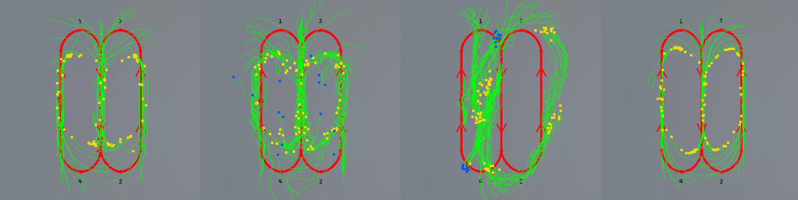
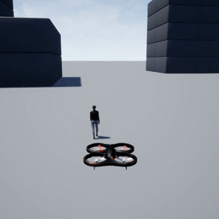
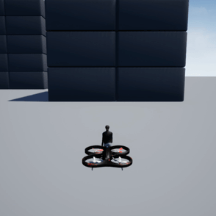
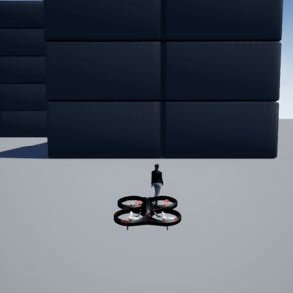
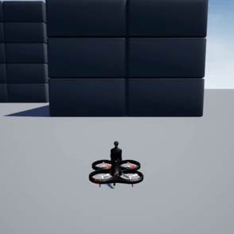
Blocksnormal: paths
= Normal
= Lost sight
= Collisions
Avg Reward: 40,2
35,2
31,9
42,0
Baseline
Single normal
Stacked normal
Single depth

Slide 17
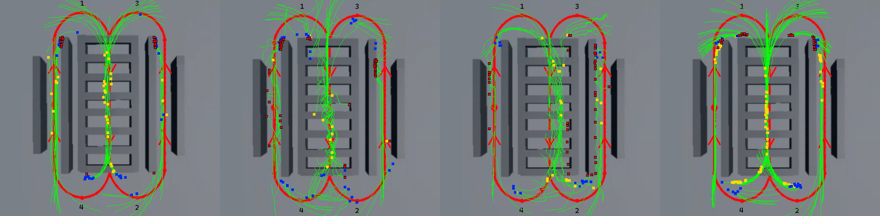
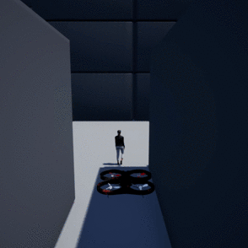
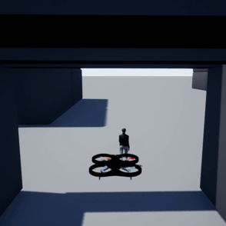
BlocksObstacles: paths
= Normal
= Lost sight
= Collisions
Avg Reward: 22,6
19,1
24,8
30,1
Baseline
Single normal
Stacked normal
STacked depth

Slide 18
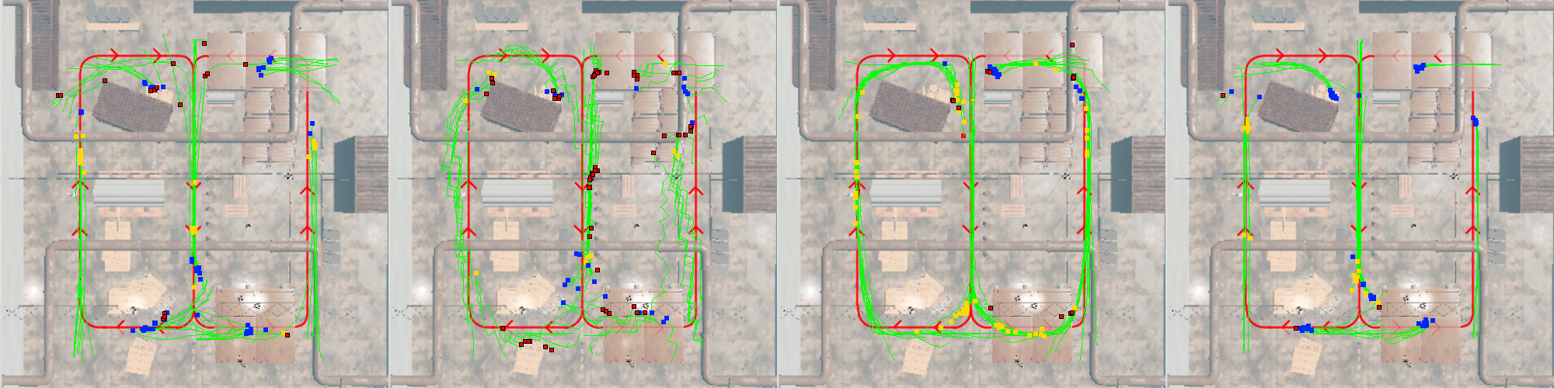
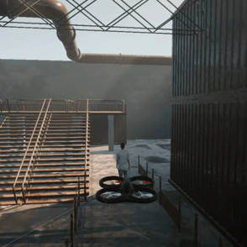
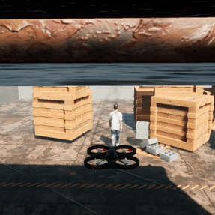
Warehouse: paths
= Normal
= Lost sight
= Collisions
Avg Reward: 9,9
11,5
13,8
21,6
Baseline
blocksnormal
blocksobstacles
Warehouse

Slide 19
New reward
Training was identical
Improved performance
More specific problematic situations
Better performance by restricting
Measured with: | Avg. Reward
Normal Reward | 39,1
Adjusted Reward | 30,2

Slide 20
conclusion

Slide 21
Conclusion: Research questions revisit
Question | Answer
RQ1 (Stacked) | Works well with obstacles, not in other environments
RQ2 (Depth) | Improved training and performance in all aspects
RQ3 (Baseline) | RL was useful in all environments, marginally without obstacles
RQ4 (Generalizability) | RL is able to generalize to more complex environments, but more research in improvements is required

Slide 22
conclusion
Reinforcement Learning is a useful implementation for follow-me behavior
More room to look at state-of-the-art movement communication
Look into how to make RL generalize better

Slide 23
Questions?

Slide 24
References
Clark, J., & Amodei, D. (2019, March 7). Faulty Reward Functions in the Wild. OpenAI. https://openai.com/blog/faulty-reward-functions/
Comi, M. (2020, March 22). How to teach AI to play Games: Deep Reinforcement Learning. Medium. https://towardsdatascience.com/how-to-teach-an-ai-to-play-games-deep-reinforcement-learning-28f9b920440a
Kansal, S., & Martin, B. (2018). Reinforcement Q-Learning from Scratch in Python with OpenAI Gym. Learndatasci. https://www.learndatasci.com/tutorials/reinforcement-q-learning-scratch-python-openai-gym/
Richmond, A. (2019, March 31). A Brief Introduction to Artificial Neural Networks. Alan Richmond. https://tuxar.uk/brief-introduction-artificial-neural-networks/
Shaikh, F. (2019, June 24). Simple Beginner’s guide to Reinforcement Learning & its implementation. Analytics Vidhya. https://www.analyticsvidhya.com/blog/2017/01/introduction-to-reinforcement-learning-implementation/#:%7E:text=Reinforcement%20Learning%20is%20learning%20what,will%20yield%20the%20maximum%20reward.
Sutton, R. S., & Barto, A. G. (2018). Reinforcement Learning, second edition: An Introduction (Adaptive Computation and Machine Learning series) (second edition). Bradford Books.
Three Things to Know About Reinforcement Learning. (2019, October). KDnuggets. https://www.kdnuggets.com/2019/10/mathworks-reinforcement-learning.html

Slide 25
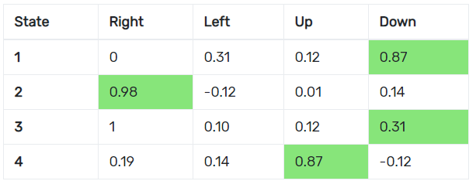
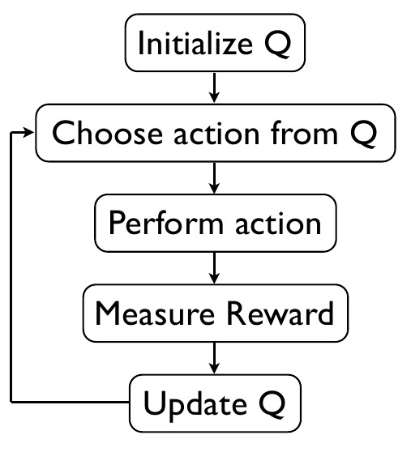
Background
Q-Learning
Deep Q-Network (DQN)
Table of states and actions
Iteratively improve itself
Future rewards
(Comi, 2020)
(Shaikh, 2019)

Slide 26
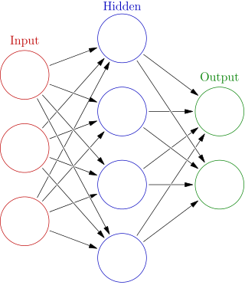
Background
Neural Networks
Deep Reinforcement Learning
Biologically inspired structure
Function approximator
Convolutional Neural Network (CNN)
(Richmond, 2019)

Slide 27

Results: blocksnormal
Baseline
Single normal
Stacked normal
Single depth

Slide 28
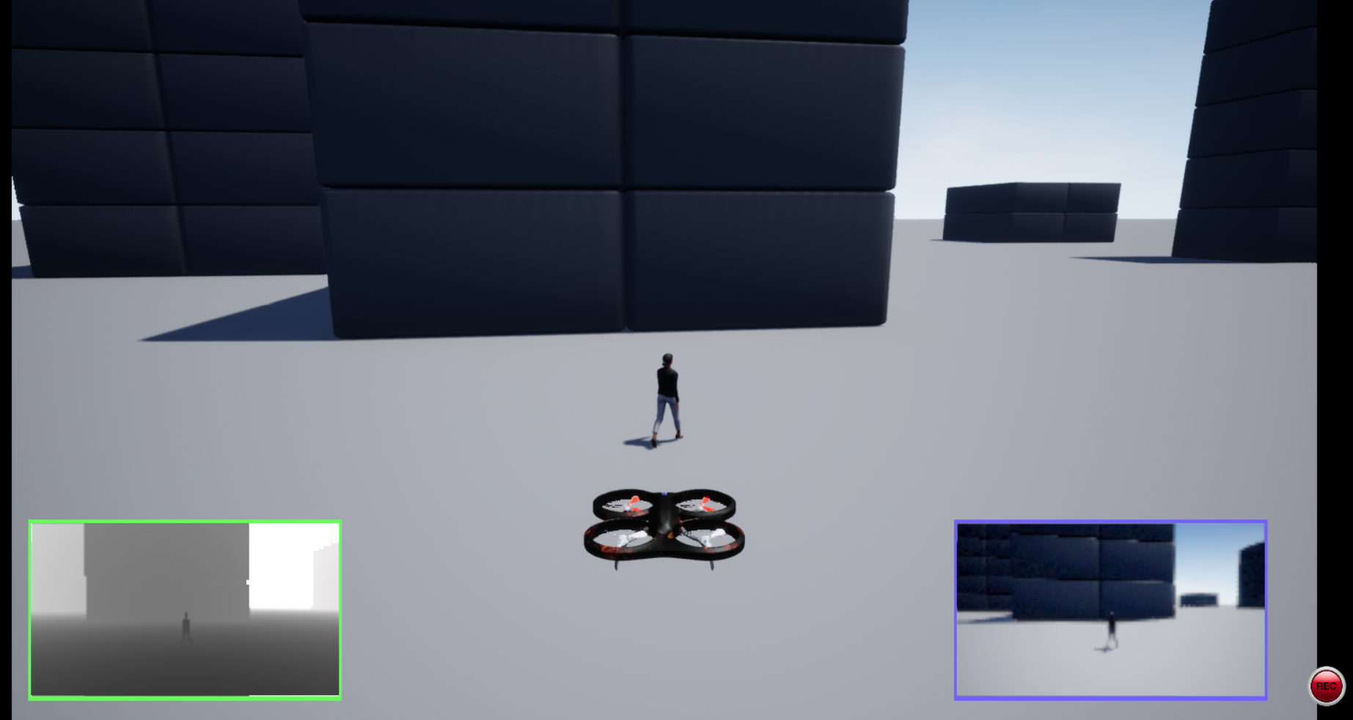
methods
Microsoft AirSim
Unreal Engine
Depth, Segmentation
and Normal

Slide 29
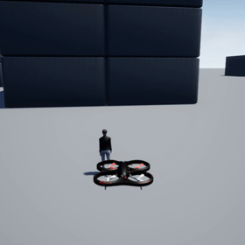
Results: blocksnormal
Baseline
Single normal
Stacked normal
Single depth

Slide 30
Results: blocksnormal
Baseline
Single normal
Stacked normal
Single depth

Slide 31
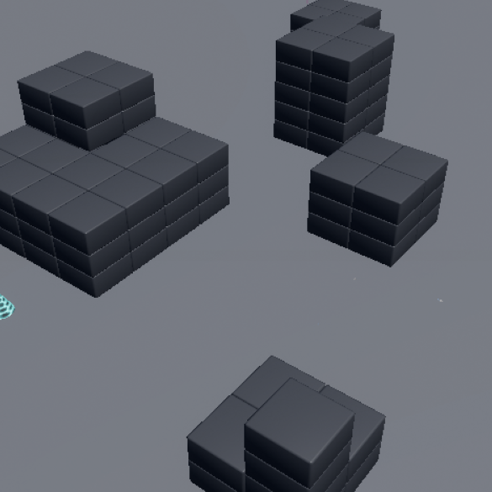
Environments
bLOCKSNORMAL
BLOCKSOBSTACLES
WAREHOUSE

Slide 32
Results: blocksnormal
Baseline
Single normal
Stacked normal
Single depth

Slide 33
Results: blocksnormal
Baseline
Single normal
Stacked normal
Single depth

